Slide 1

Data Purification Using Machine Learning
Presented by Grant Sherrill
Data provided by Jaan & Jaana Mannik

Slide 2
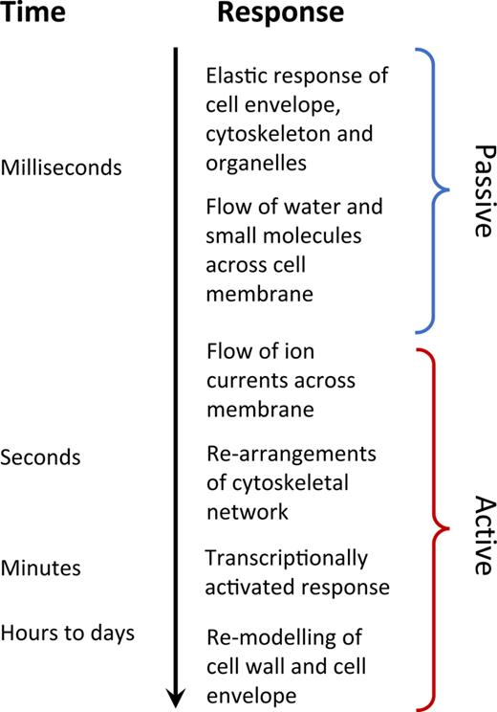
Background
The majority biological samples are “measured” by taking videos of cells which have undergone some procedure
Data sets are difficult to interpret due to qualitative judgement being necessary for interpretation
Large data sets are required as cells change in microscopic times but have macroscopic properties
(1)
Männik, J.; Teshima, T. F.; Wolfrum, B.; Yang, D. Lab-on-a-Chip Based Mechanical Actuators and Sensors for Single-Cell and Organoid Culture Studies. Journal of Applied Physics 2021, 129 (21), 210905. https://doi.org/10.1063/5.0051875.

Slide 3
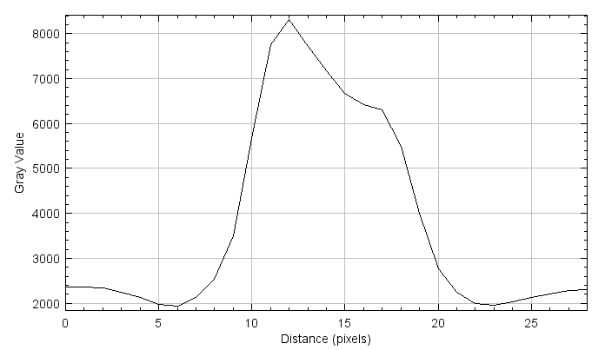
Raw Data
The targets of our data set are the cells inside of the channel shown to the right
We want to be able to reconstruct cells and track movement as a function of time, which requires pixel perfect accuracy
Typical image analysis techniques fail due to our target being an intermediate intensity.
Bg
Cell

Slide 4
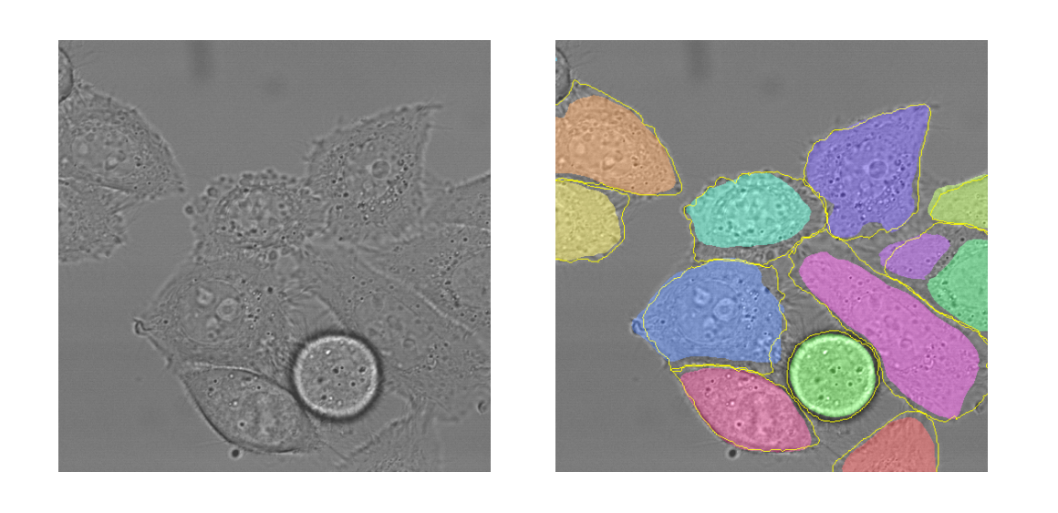
Problem Statement
This project aims to pre-process data via convolutional neural networks for ease of further analysis
Previous approaches, such as the U-net have found moderate success at tracking cells
Result of U-Net which identifies different cells, but not entire bodes
Ronneberger, O.; Fischer, P.; Brox, T. U-Net: Convolutional Networks for Biomedical Image Segmentation. arXiv May 18, 2015. http://arxiv.org/abs/1505.04597 (accessed 2023-01-05).

Slide 5

Problems with U-Net
The classic U-Net has some shortcomings, as seen by the preliminary testing
Other developments such as Cellpose have been created which track cells quite well, but cannot be adjusted to match specific experimental design
U-Net trained with binary images

Slide 6
Inputs and Outputs
Input
Target
We want to create images without background, as we can manipulate this data easily
The targets are channels that have the channel noise subtracted by subtracting empty channel data from each frame in a movie
This does not work for most frames, so the target set has been curated

Slide 7
The Network
A convolutional neural network is being employed, following the U-net architecture
Residual blocks have been introduced to increase accuracy
The standard binary classification has been replaced by MSE.
1
32
32
32
32
Residual Block
Input
64
64
64
64
Output
MaxPool
128
128
128
128
3X3 Conv. & ReLU
256
256
Concatenate

Slide 8
Results
Shown here is the original image, the target, the network output, and the output subtracted from the original image
It is visually evident that the network produces an image similar to the input
The network had a final error of 0.0007 implying there was strong convergence

Slide 9
Looking at Unseen Data
Shown here is output from a different day of testing which has different lighting and channel topology than the training set
For very noisy data there seems to still be some confusion, but it performs fairly well

Slide 10
Quantifying Results
To get an idea of how well the network did the normalized square root of the mean square error was calculated for the training data and the evaluation
The normalized square root of the mean square error has an average of 0.1 across the evaluation data, with only a slightly larger tail than the training data

Slide 11

Ability to Generate Data
The goal of this project is to see if we can take the network output and create binary images from the result
Shown here is a basic otsu threshold applied to the output, which can get smoothed out by other functions later

Slide 12
Interpretation
In this form, the data can be thresholded to create binary images
Image processing can temporally track shapes from movies which have binaries associated with them
The low error rate shows our network was trained well and can produce accurate results based on what it was trained

Slide 13
Conclusion
The goal of this project was achieved with minor room for improvement
Data can be taken and analyzed via normal image analysis techniques
Tracking cells across entire movies is possible using these processed images
While more complicated solutions exist, this method works to simplify the problem to one with known solutions

